Slide 1

Everyday Ethiopian Objects
Fulbright Ethiopia: Indigenous Wisdom and Culture
Created by: Geraldine Truog and Kate Van Haren

Slide 2
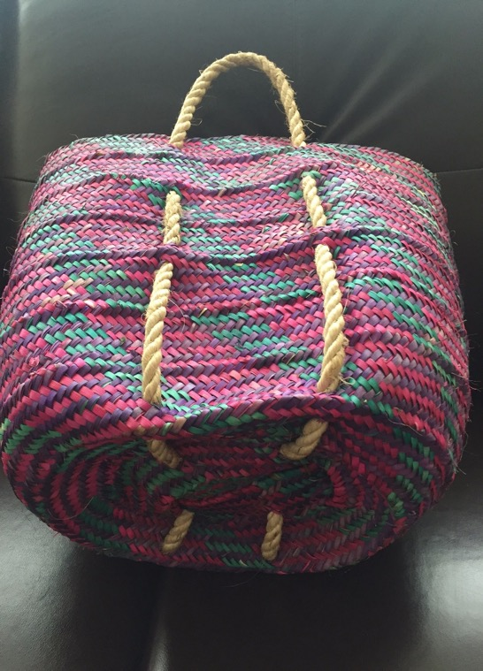
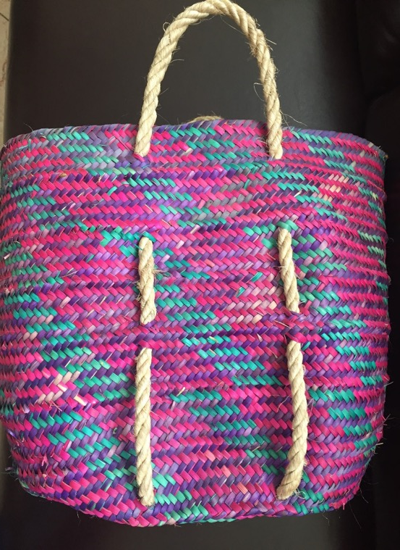
#1
1. What is it?
2. What is it made of?
3. What is it used for?
4. How is it used?
5. What does the United States have that compares to it?
6. How is it made?
7. Do men, women, both, or neither make it?

Slide 3
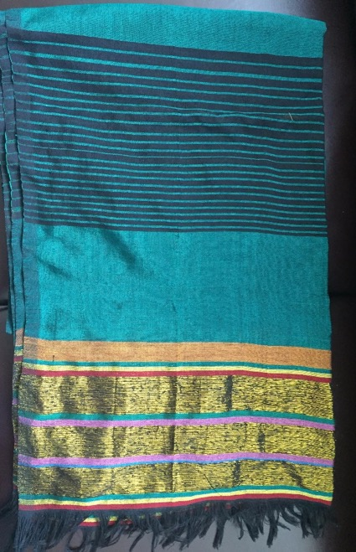
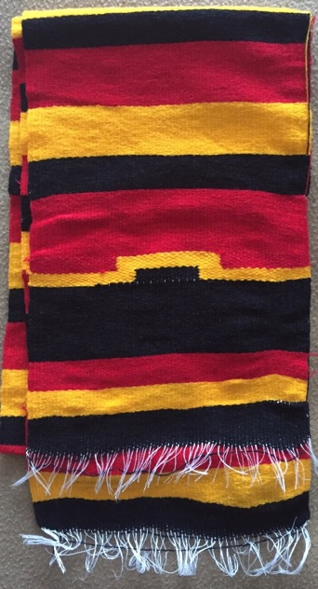
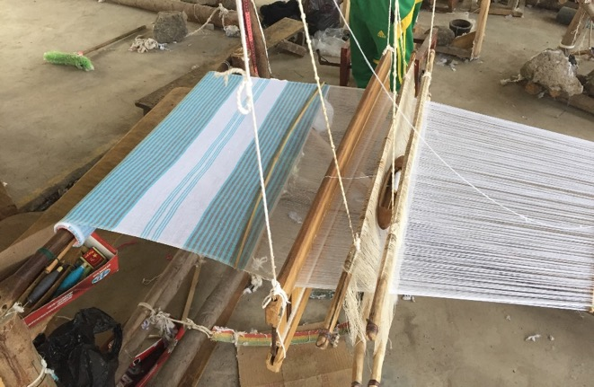
1. What is it?
2. What is it made of?
3. What is it used for?
4. How is it used?
5. What does the United States have that compares to it?
6. How is it made?
7. Do men, women, both, or neither make it?
#2

Slide 4
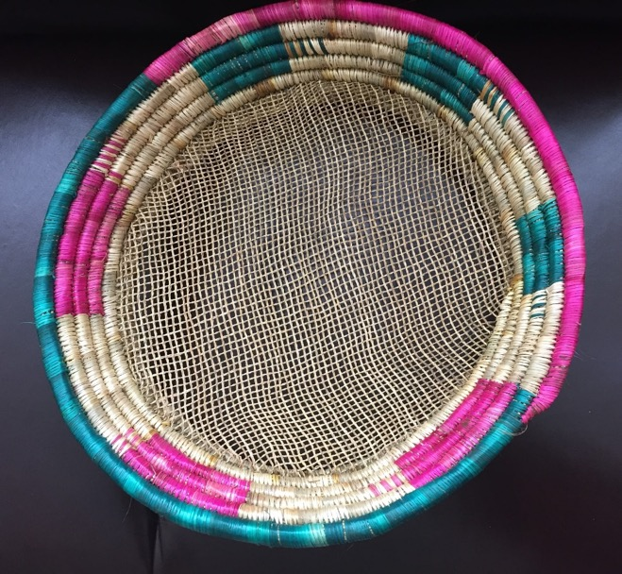
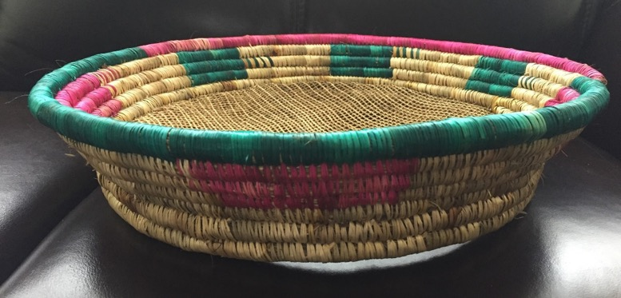
1. What is it?
2. What is it made of?
3. What is it used for?
4. How is it used?
5. What does the United States have that compares to it?
6. How is it made?
7. Do men, women, both, or neither make it?
#3

Slide 5
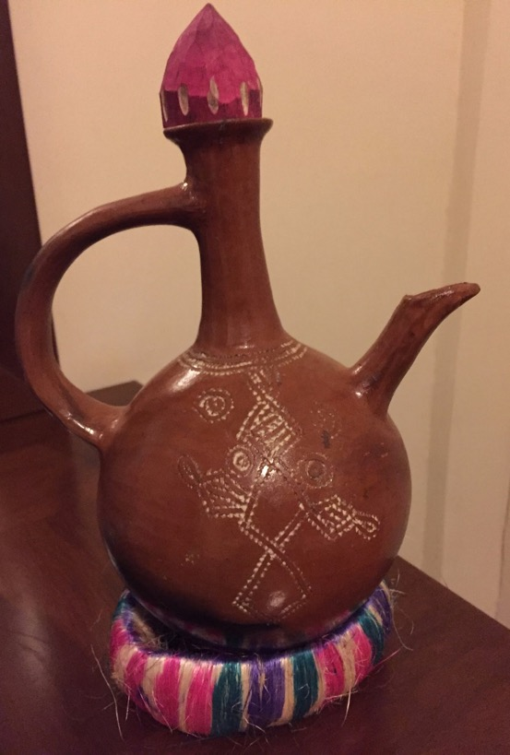
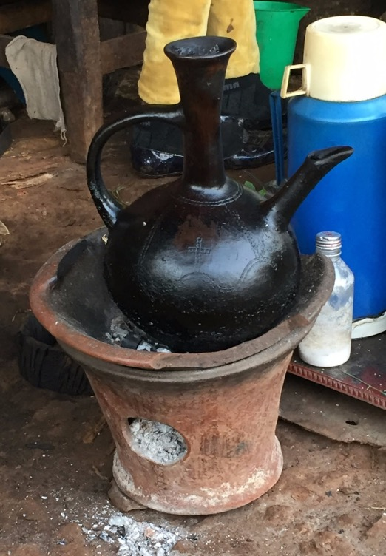
#4
1. What is it?
2. What is it made of?
3. What is it used for?
4. How is it used?
5. What does the United States have that compares to it?
6. How is it made?
7. Do men, women, both, or neither make it?

Slide 6
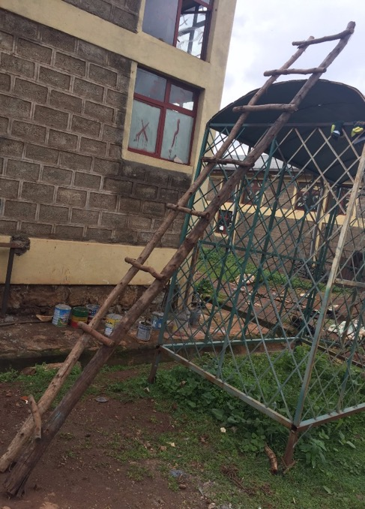
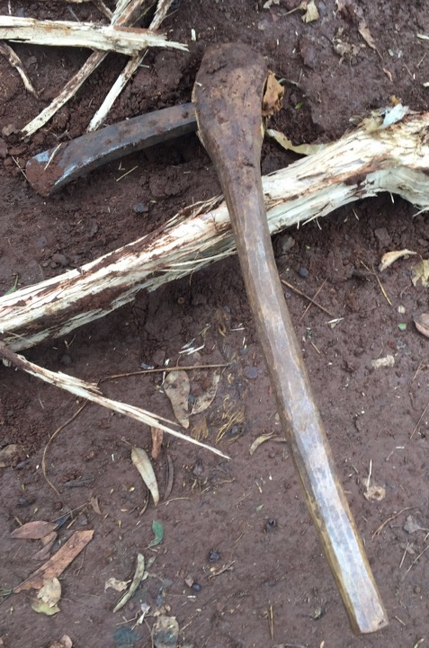
#5
1. What is it?
2. What is it made of?
3. What is it used for?
4. How is it used?
5. What does the United States have that compares to it?
6. How is it made?
7. Do men, women, both, or neither make it?
A
B

Slide 7
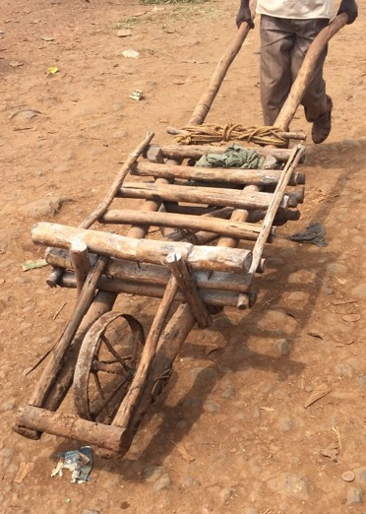
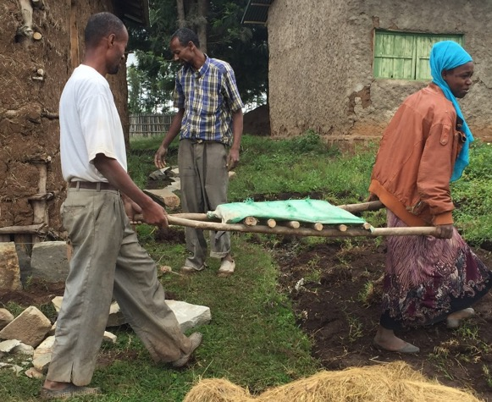
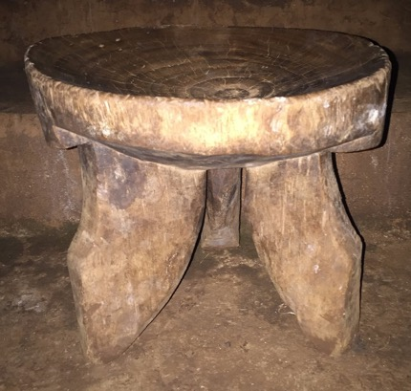
#5 Cont.
C
D
E

Slide 8
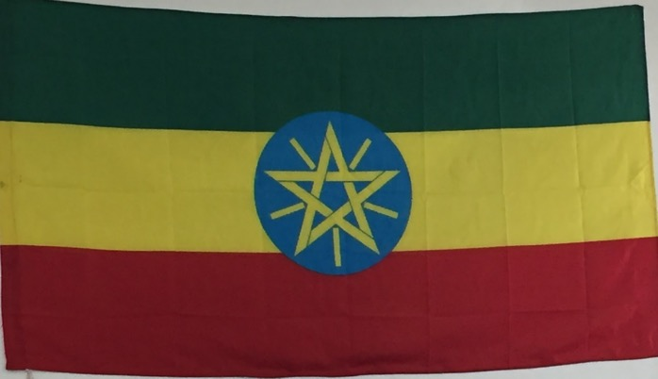
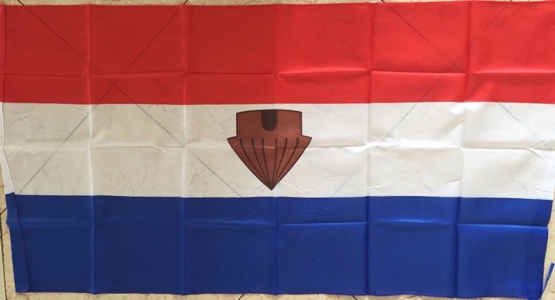
#6
1. What is it?
2. What is it made of?
3. What is it used for?
4. How is it used?
5. What does the United States have that compares to it?
6. How is it made?
7. Do men, women, both, or neither make it?

Slide 9
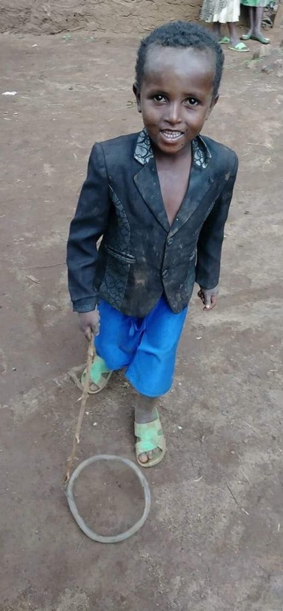
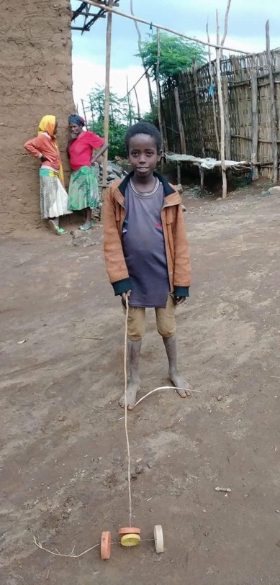
#7
1. What is it?
2. What is it made of?
3. What is it used for?
4. How is it used?
5. What does the United States have that compares to it?
6. How is it made?
7. Do men, women, both, or neither make it?

Slide 10
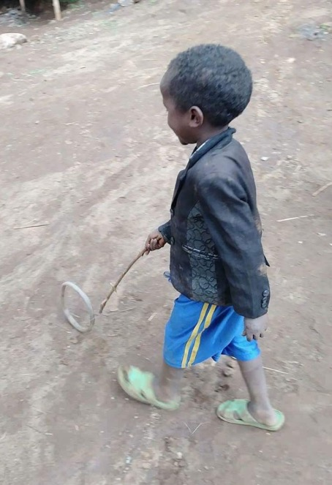
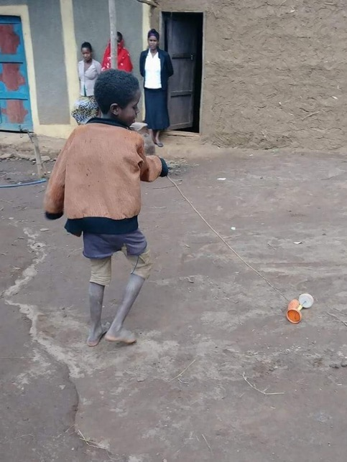
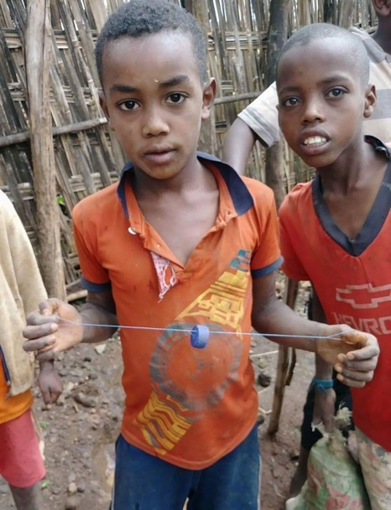
#7 Cont.

Slide 11
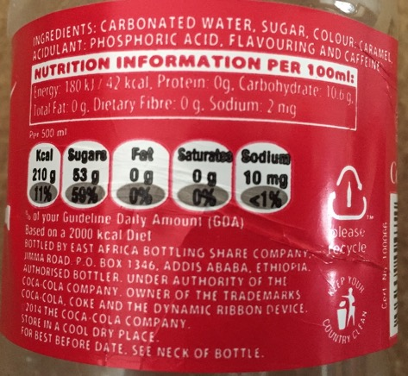
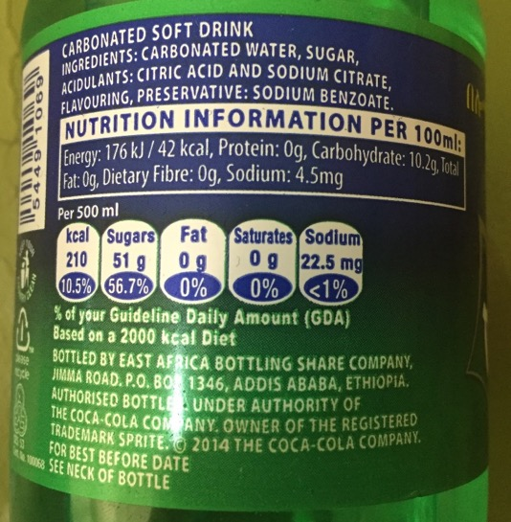
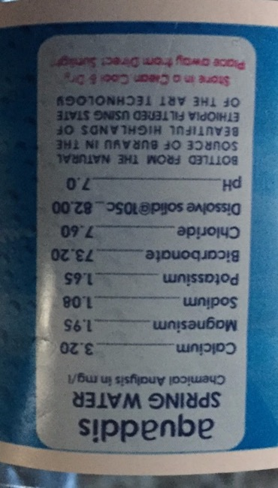
#8
1. What is it?
2. What is it made of?
3. What is it used for?
4. How is it used?
5. What does the United States have that compares to it?
6. How is it made?
7. Do men, women, both, or neither make it?

Slide 12
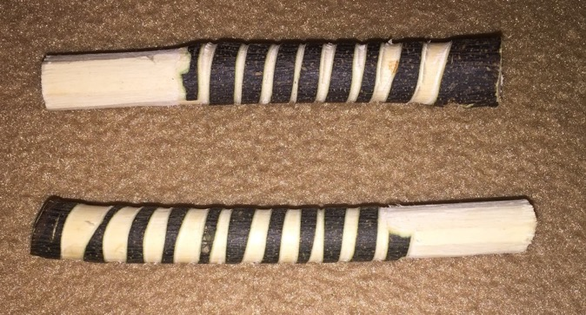
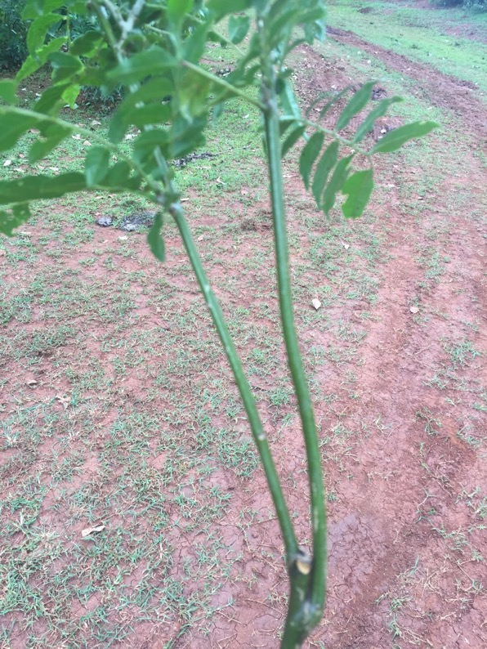
#9
1. What is it?
2. What is it made of?
3. What is it used for?
4. How is it used?
5. What does the United States have that compares to it?
6. How is it made?
7. Do men, women, both, or neither make it?

Slide 13
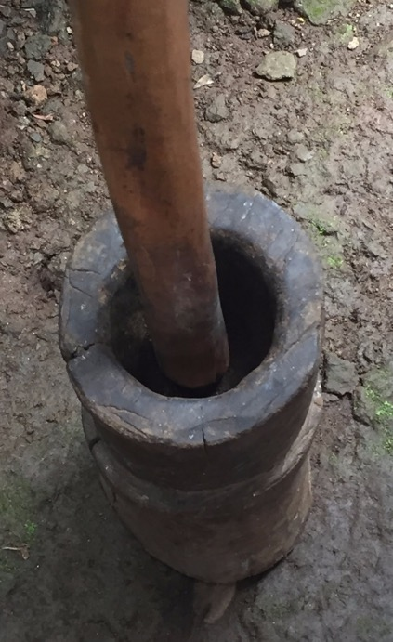
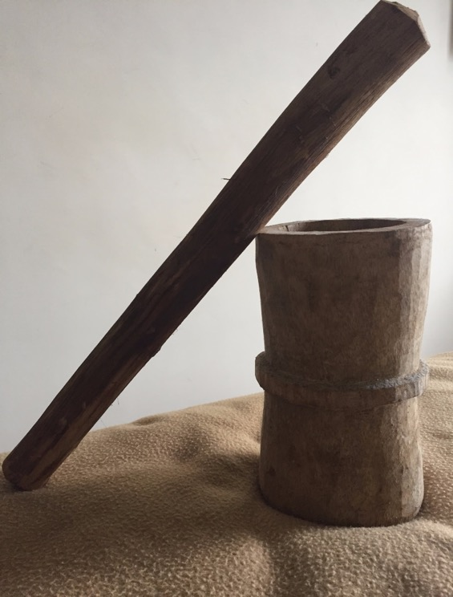
#10
1. What is it?
2. What is it made of?
3. What is it used for?
4. How is it used?
5. What does the United States have that compares to it?
6. How is it made?
7. Do men, women, both, or neither make it?

Slide 14
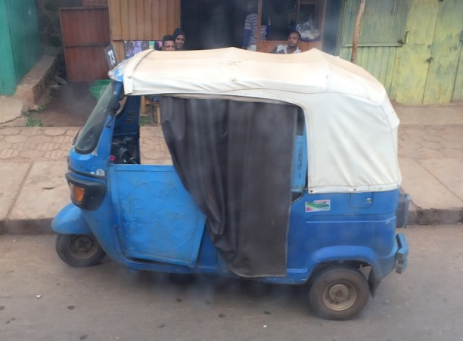
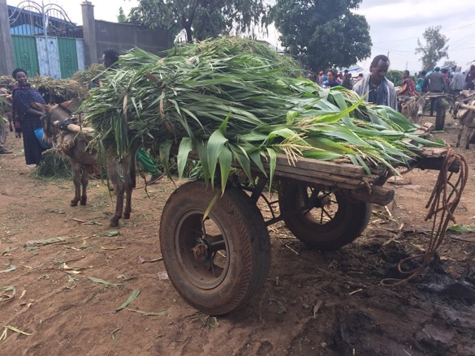
#11
A
B
1. What is it? 2. What is it made of?
3. What is it used for? 4. How is it used?
5. What does the United States have that compares to it? 6. How is it made?
7. Do men, women, both, or neither make it?

Slide 15
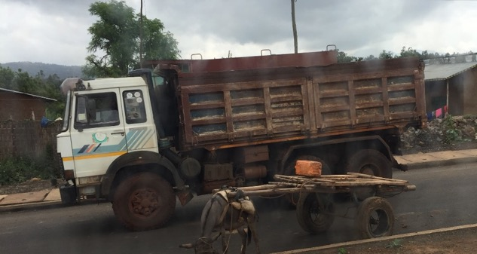
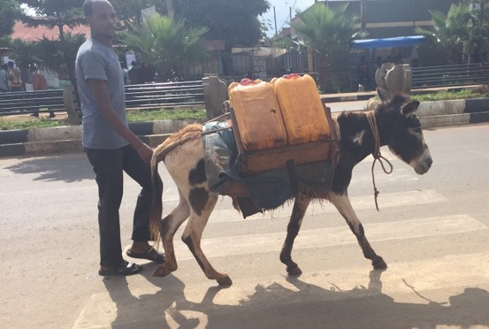
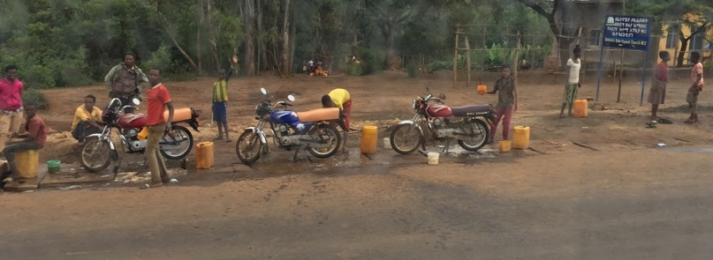
#11 Cont.
C
D
E

Slide 16
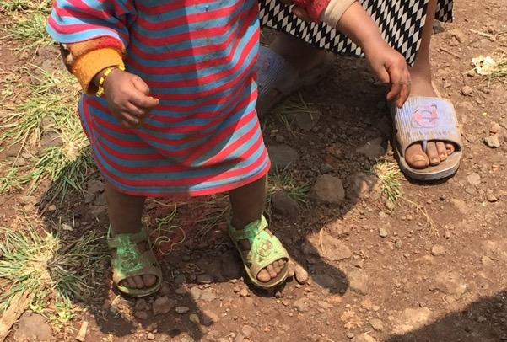
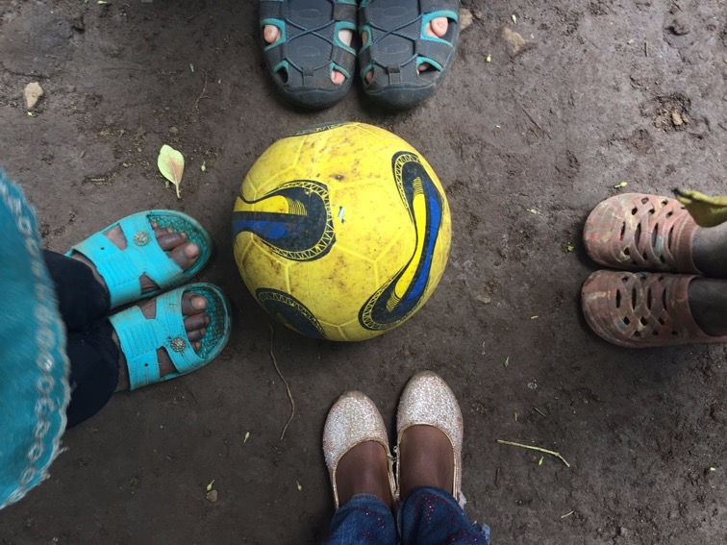
#12
1. What is it?
2. What is it made of?
3. What is it used for?
4. How is it used?
5. What does the United States have that compares to it?
6. How is it made?
7. Do men, women, both, or neither make it?

Slide 17
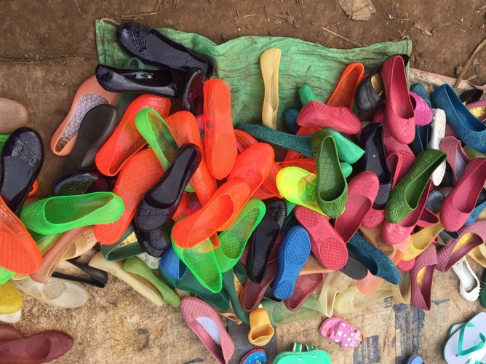
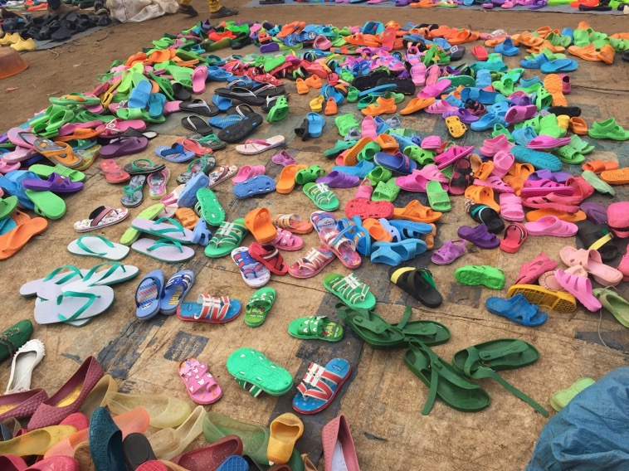
#12 Cont

Slide 18
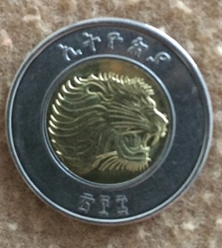
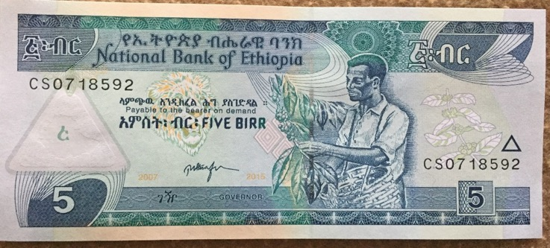
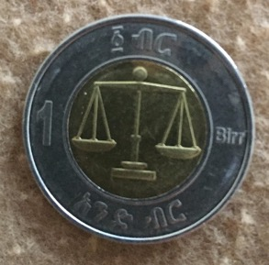
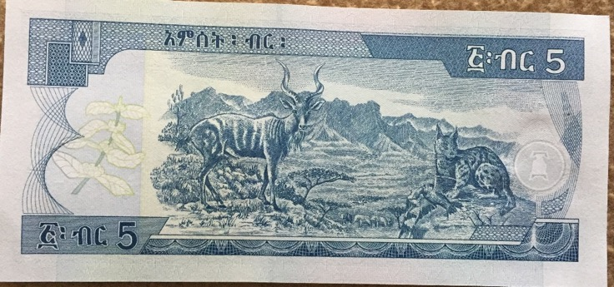
#13
1. What is it?
2. What is it made of?
3. What is it used for?
4. How is it used?
5. What does the United States have that compares to it?
6. How is it made?
7. Do men, women, both, or neither make it?

Slide 19
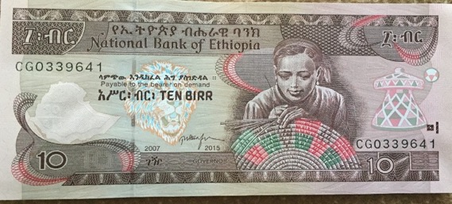
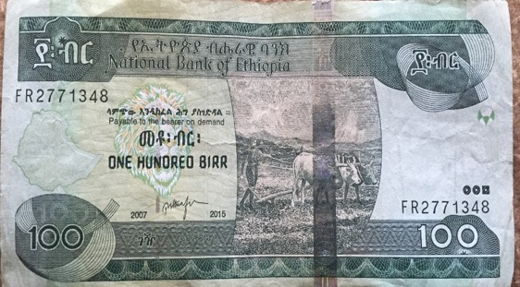
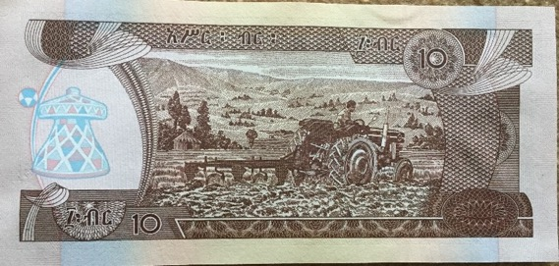
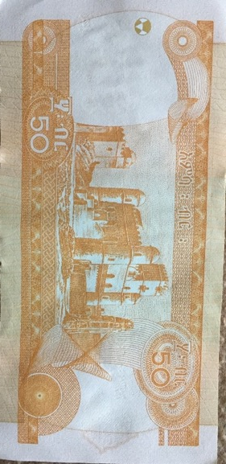
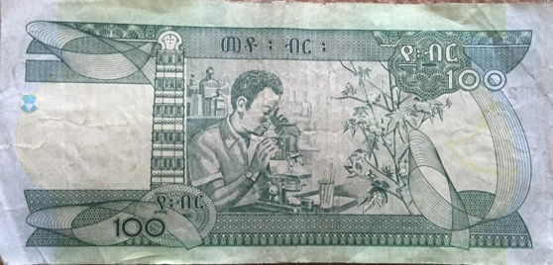
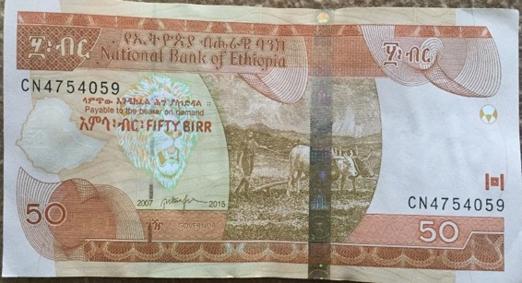
#13 Cont.

Slide 20
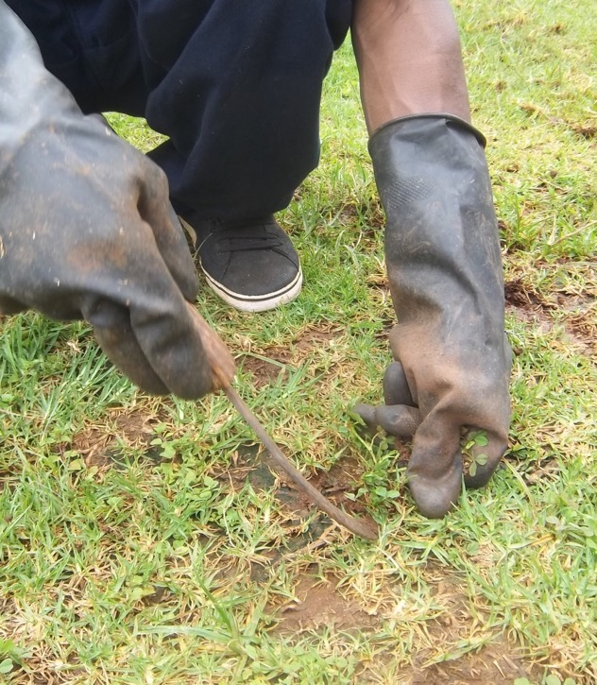
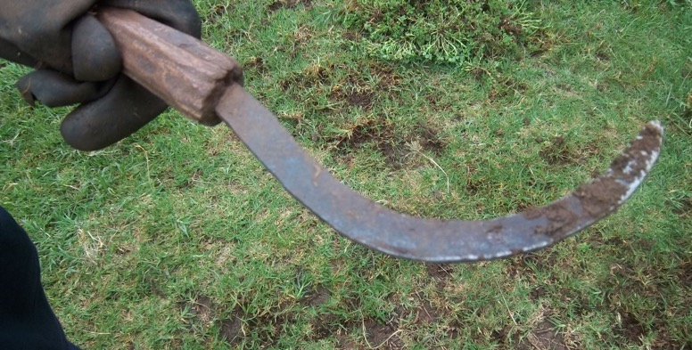
#14
1. What is it? 2. What is it made of?
3. What is it used for? 4. How is it used?
5. What does the United States have that compares to it?
6. How is it made?
7. Do men, women, both, or neither make it?

Slide 21
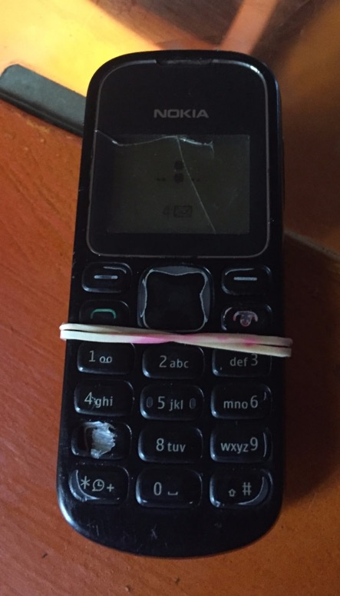

#15
1. What is it?
2. What is it made of?
3. What is it used for?
4. How is it used?
5. What does the United States have that compares to it?
6. How is it made?
7. Do men, women, both, or neither make it?

